Slide 1
CSCI -112 Introduction to computer Systems
LAB
Instructor: Santanu Banerjee

Slide 2
Programming Exercise

Slide 3
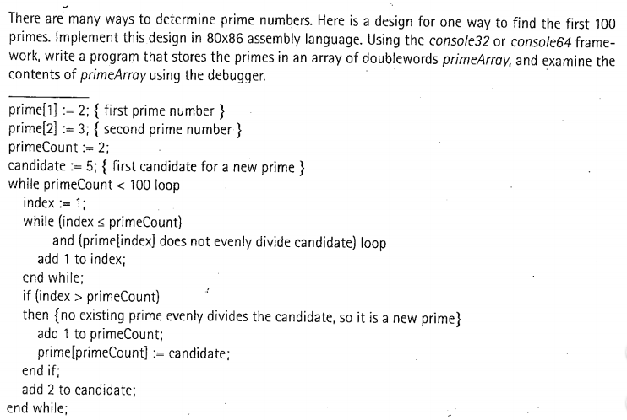
Exercise - 8
Write an assembly program, show your instructor.
Submit your code on Blackboard.
10 points

